Slide 1

Tech Instagram Influencer Analysis

Slide 2

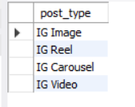
1. How many unique post types are found in the 'fact_content' table?
Query:
SELECT distinct post_type
FROM fact_content ;

Slide 3
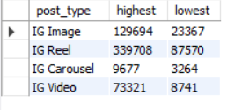
2. What are the highest and lowest recorded impressions for each post type?
Query:
SELECT post_type, max(impressions) as highest, min(impressions) as lowest
FROM fact_content
GROUP BY post_type;

Slide 4
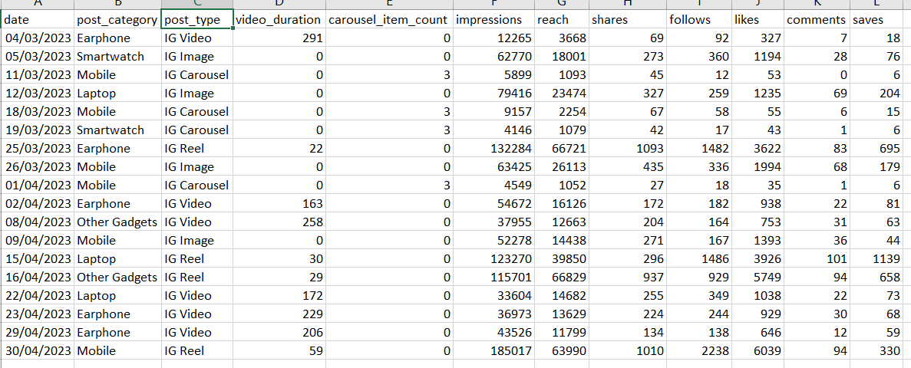
3. Filter all the posts that were published on a weekend in the month of March and April and export them to a separate csv file.
Query:
SELECT a.*
FROM fact_content a
JOIN dim_dates b
ON a.date = b.date
WHERE month_name IN ('March', 'April') AND weekday_or_weekend = 'weekend';

Slide 5
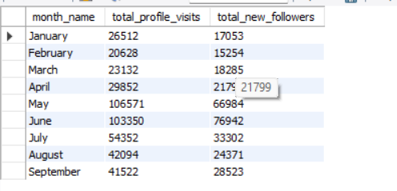
4. Create a report to get the statistics for the account. The final output includes the following fields:
• month_name • total_profile_visits • total_new_followers
Query:
SELECT month_name,sum(profile_visits) as total_profile_visits, sum(new_followers) as total_new_followers
FROM fact_account a
JOIN dim_dates b
ON a.date = b.date
GROUP BY month_name;

Slide 6
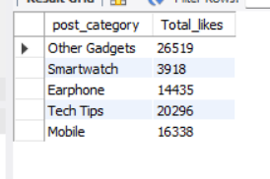
5. Write a CTE that calculates the total number of 'likes’ for each 'post_category' during the month of 'July' and subsequently, arrange the 'post_category' values in descending order according to their total likes.
Query:
WITH category_likes AS (
SELECT post_category, SUM(likes) AS total_likes
FROM fact_content a
JOIN dim_dates b
ON a.date = b.date
WHERE b.month_name = 'July'
GROUP BY post_category)
SELECT *
FROM category_likes
ORDER BY total_likes DESC;

Slide 7
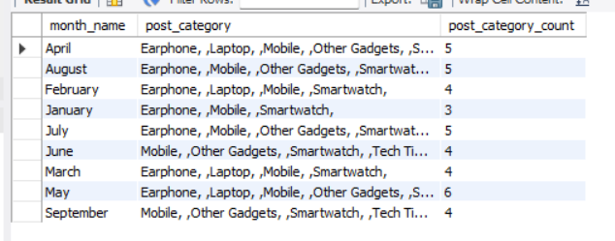
6. Create a report that displays the unique post_category names alongside their respective counts for each month. The output should have three columns:
• month_name • post_category_names • post_category_count
Query:
SELECT month_name, group_concat(distinct post_category, ', ') as post_category, count(distinct post_category) as post_category_count
FROM fact_content a
JOIN dim_dates b
ON a.date = b.date
GROUP BY month_name;

Slide 8
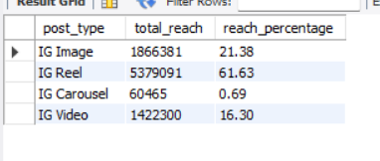
7. What is the percentage breakdown of total reach by post type? The final output includes the following fields:
• post_type • total_reach • reach_percentage
Query:
SELECT post_type,
SUM(reach) AS total_reach, ROUND(SUM(reach) * 100.0 / (SELECT SUM(reach) FROM fact_content), 2) AS reach_percentage
FROM fact_content
GROUP BY post_type;

Slide 9
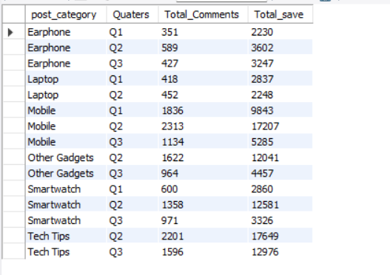
8. Create a report that includes the quarter, total comments, and total saves recorded for each post category. Assign the following quarter groupings:
The final output columns should consist of:
• post_category • quarter • total_comments • total_saves
Query:
SELECT post_category,
CASE
WHEN month_name IN ('January','February','March’)
THEN 'Q1'
WHEN month_name IN ('April','May','June') THEN 'Q2'
WHEN month_name IN ('July','August','September’)
THEN 'Q3’
END AS Quaters,
SUM(comments) AS Total_Comments, SUM(saves) AS Total_save
FROM fact_content a
JOIN dim_dates b
ON a.date = b.date
GROUP BY post_category,Quarters
ORDER BY post_category, Quaters;

Slide 10
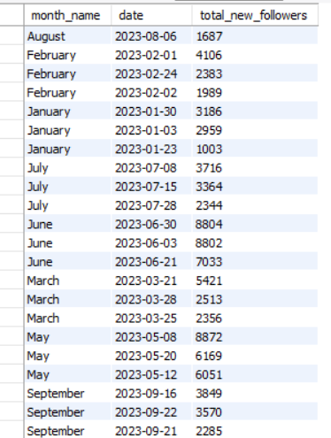
9. List the top three dates in each month with the highest number of new followers. The final output should include the following columns:
• month • date • new_followers
Query:
with follower_rnk as (
SELECT b.month_name as month_name,a.date as date,
SUM(new_followers) as total_new_followers, dense_rank() over(partition by b.month_name order by SUM(new_followers) desc) as rnk
FROM fact_account a
JOIN dim_dates b
ON a.date = b.date
GROUP BY b.month_name,b.date
)
SELECT month_name,date,total_new_followers
FROM follower_rnk
WHERE rnk <=3

Slide 11
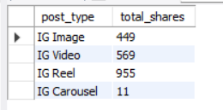
10. Create a stored procedure that takes the 'Week_no' as input and generates a report displaying the total shares for each 'Post_type'. The output of the procedure should consist of two columns:
• post_type • total_shares
Query:
DELIMITER //
CREATE PROCEDURE get_total_shares_by_week(IN input_week VARCHAR(5))
BEGIN
SELECT a.post_type, SUM(a.shares) AS total_shares
FROM fact_content a
JOIN dim_dates b
ON a.date = b.date
WHERE b.week_no = input_week
GROUP BY a.post_type;
END //
DELIMITER ;
call gdb0120.get_total_shares_by_week('W2');

